Slide 1
TITLE: SURVIVAL ANALYSIS: TIME FROM BIRTH TILL FIRST TERTIARY INSTITUTION ADMISSION
Oloyede Abdulganiyu Opeyemi
17/56EG105

Slide 2
OUTLINE
Introduction
Aim and objectives
Source of data
Methodology
Data Analysis
Summary
References

Slide 3
Introduction
Survival analysis, also known as time-to-event analysis is a branch of statistics for analyzing the expected duration of time until an event occurs. In engineering, the methodology is known as reliability engineering while the economist knows it as duration modeling.
Survival analysis is the branch of statistics that deals with the collection of statistical procedures and for data analytics, for which the dependent variable is the time until an event occurs (Kleinbaum and Klein, 2005).
The time variable, otherwise known as the survival time because it gives the time that an individual has survived over some follow-up period. Event, also known as failure in some cases may range from death, recovery, relapse, loan repayment, load default, churn a product, patent approval, staff promotion, business failure, readmission of patients, second child and even admission to tertiary institution and much more.

Slide 4
Aim and Objectives
This study is aimed at quite some objectives, the following are but a few of them:
To perform exploratory data analysis
To perform non-parametric survival exploration of the data
To estimate and interprete survival function and hazard function from the data
To compare survivor functions

Slide 5
Source of Data
This work is based on primary data collected from 207 respondents all over various parts of the country in no particular order.
Data was collected via questionnaire carefully designed and distributed using google forms
Data collected include the following variables or responses:
Gender
Age
Name of tertiary institution
Type of tertiary institution
Number of times you attempted O-level examination
Types of ownership of secondary school attended
Living in secondary school (day or boarder)
Type of family structure
Department at secondary school
Base (Rural or urban)
Have you ever been admitted into a tertiary institution?
Age at first tertiary institution admission
Sponsor
Education attainment
Agreement with the following assertion?
“Education is the best legacy”
“school is scam”

Slide 6
Methodology
Some of the methodologies used for the data analysis are:
Spatial map for data visualization
Survivor function
Hazard function
Kaplan-Meier survivor curve
Log-rank test statistics
Nelson-Aalen cummulative hazard rate
Cox ph Model

Slide 7
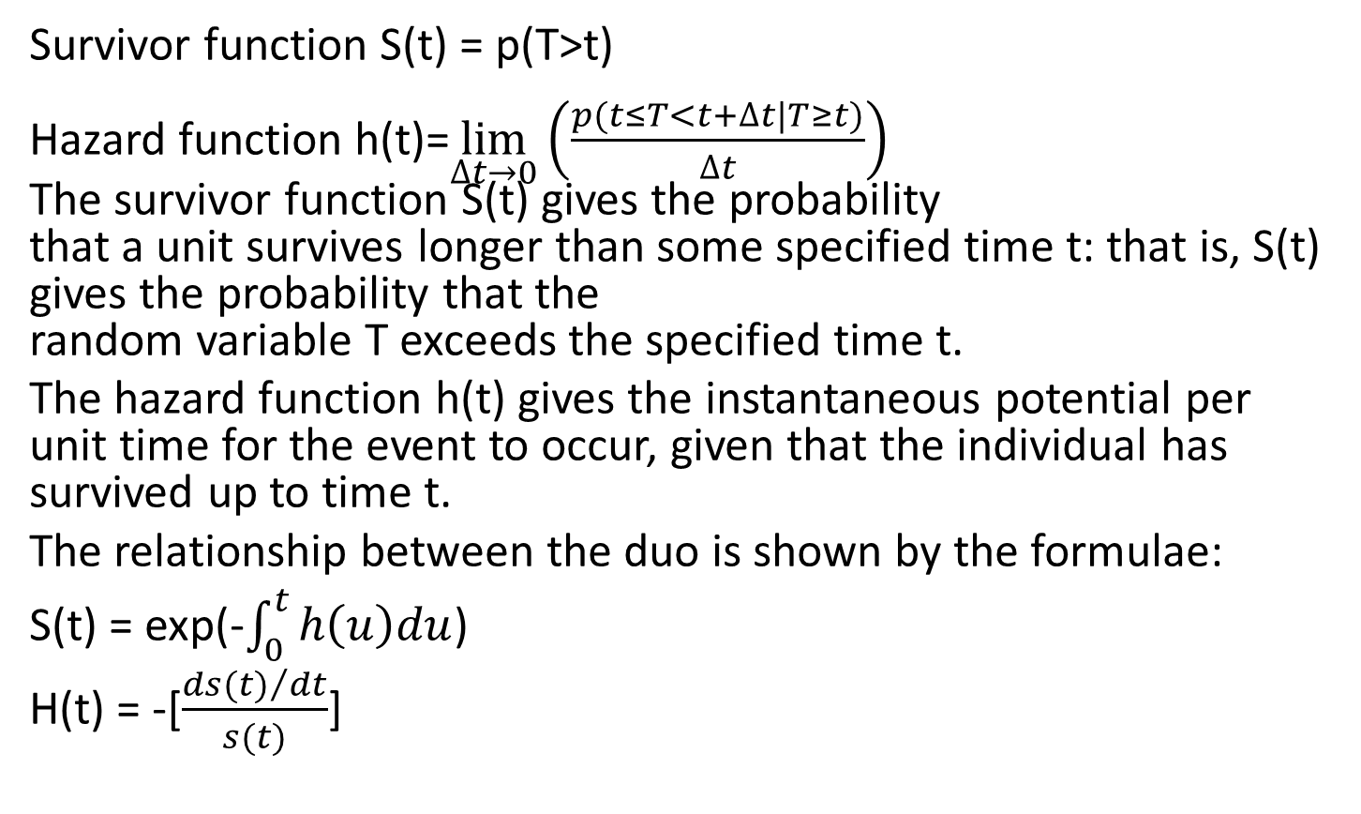
Survivor function and Hazard function
Survivor function S(t) = p(T>t)
Hazard function h(t)=$\lim_{∆t→0}{{\left(\frac{p(t≤T<t+∆t|T≥t)}{∆t}\right)}^{}}$ The survivor function S(t) gives the probability that a unit survives longer than some specified time t: that is, S(t) gives the probability that the random variable T exceeds the specified time t.
The hazard function h(t) gives the instantaneous potential per unit time for the event to occur, given that the individual has survived up to time t.
The relationship between the duo is shown by the formulae:
S(t) = exp(-$\int_{0}^{t}{h\left(u\right)du}$)
H(t) = -[$\frac{{ds(t)}/{dt}}{s(t)}$]

Slide 8
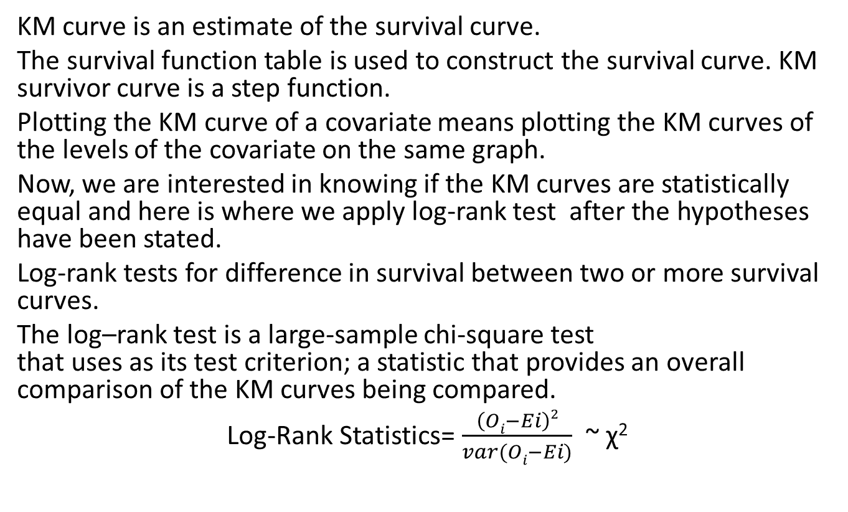
Kaplan-Meier survival curve and Log-Rank Test
KM curve is an estimate of the survival curve.
The survival function table is used to construct the survival curve. KM survivor curve is a step function.
Plotting the KM curve of a covariate means plotting the KM curves of the levels of the covariate on the same graph.
Now, we are interested in knowing if the KM curves are statistically equal and here is where we apply log-rank test after the hypotheses have been stated.
Log-rank tests for difference in survival between two or more survival curves.
The log–rank test is a large-sample chi-square test that uses as its test criterion; a statistic that provides an overall comparison of the KM curves being compared.
Log-Rank Statistics= $\frac{\left(Oi−Ei\right)2}{var(Oi−Ei)}$ ~ χ²

Slide 9
Hypothesis and log-rank Test
We would like to know if the estimated survivor functions are statistically equivalent. First thing first, we set up hypothesis, null(H₀) and alternate hypothesis (H₁) where H0 is our claim as the researcher and it says " there is no statistical difference in survival functions (curve) between the levels of covariate "while the H₁ is trying to debunk our claim saying "there is difference in at least one pair of survival functions“
Nelson-Aalen Cumulative Hazard Rate Nelson-Aalen is to hazard function what Kaplan-Meier is to survival function.
The Nelson-Aalen cumulative hazard estimate is non decreasing.

Slide 10
Data Analysis
Data Description and Understanding
Data summary
Name | project_data
Number of rows Censored failure | 207 16 191
Number of columns | 17
factor | 15
numeric | 2

Slide 12
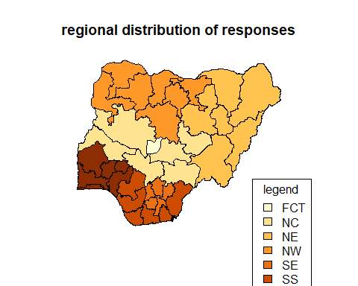
Data Visualization
The choropleth map of Nigeria bordered by zone and showing the number of responses by geo_political zones

Slide 13
Pie Chart Of The Gender Distribution Of Responses

Slide 14
Overall Survivor Function Table
## time n.risk m.event survival std.err lower 95% CI upper 95% CI ## 15 207 7 0.9662 0.0126 0.94187 0.9911 ## 16 200 28 0.8309 0.0261 0.78139 0.8836 ## 17 170 47 0.6012 0.0342 0.53781 0.6720 ## 18 122 46 0.3745 0.0339 0.31364 0.4472 ## 19 72 32 0.2081 0.0289 0.15847 0.2732 ## 20 38 15 0.1259 0.0240 0.08662 0.1831 ## 21 20 6 0.0882 0.0212 0.05501 0.1413 ## 22 13 5 0.0542 0.0177 0.02866 0.1027 ## 23 7 1 0.0465 0.0168 0.02295 0.0942 ## 24 5 2 0.0279 0.0143 0.01021 0.0762 ## 25 3 1 0.0186 0.0122 0.00515 0.0672 ## 28 1 1 0.0000 NaN NA NA
## strata median lower upper ## 1 All 18 18 18

Slide 15
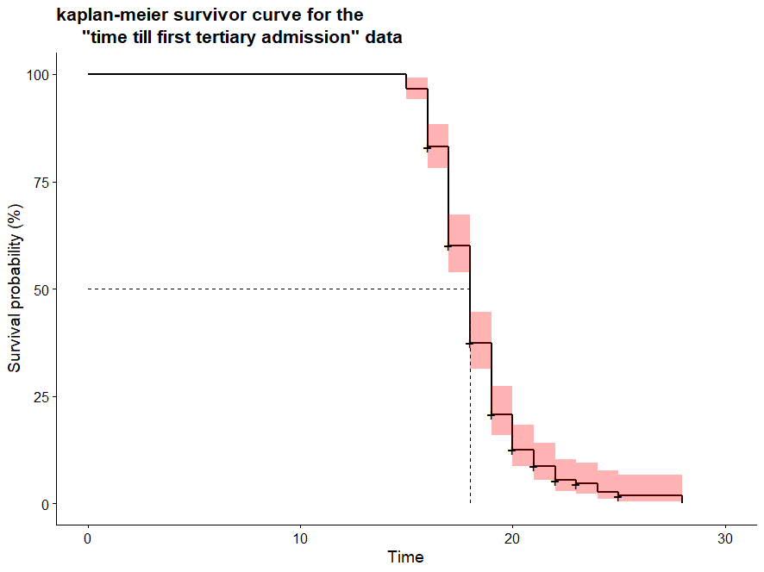

Slide 16
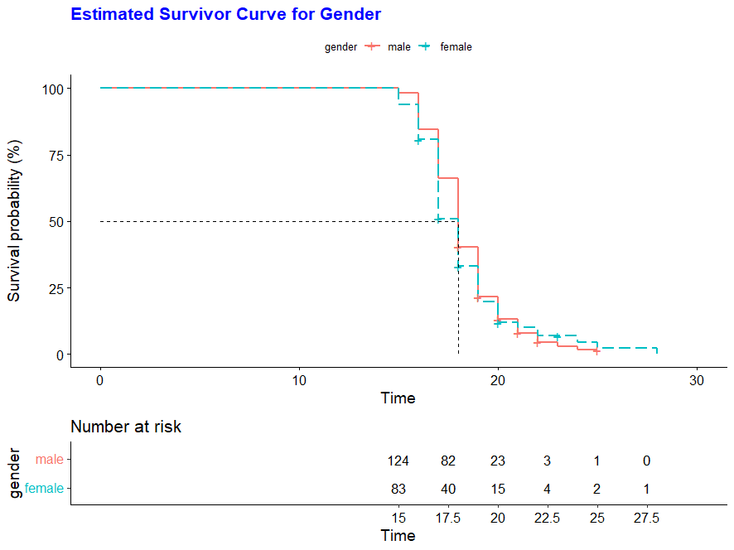
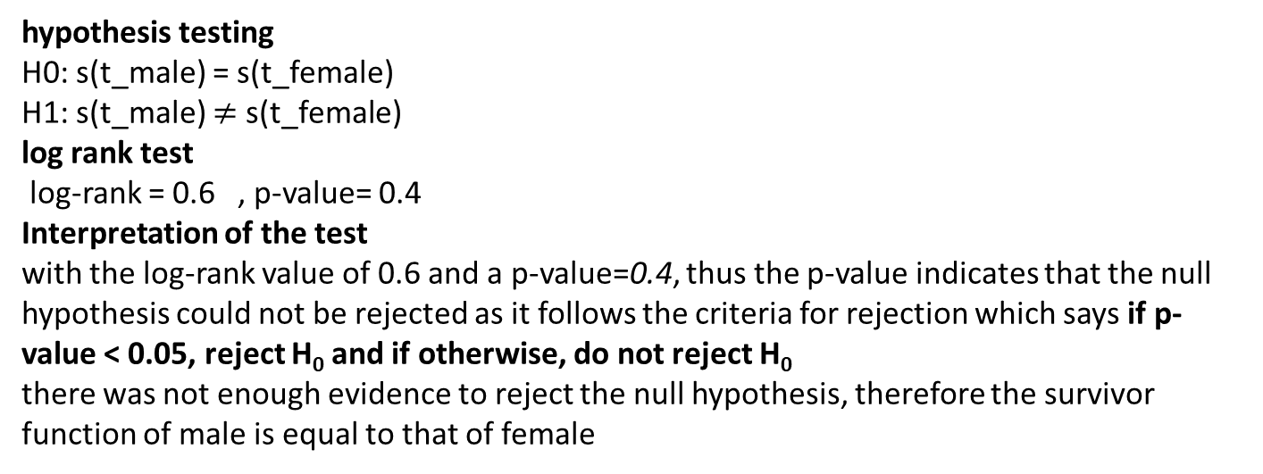
hypothesis testing H0: s(t_male) = s(t_female) H1: s(t_male) $≠$ s(t_female)
log rank test
log-rank = 0.6 , p-value= 0.4
Interpretation of the test
with the log-rank value of 0.6 and a p-value=0.4, thus the p-value indicates that the null hypothesis could not be rejected as it follows the criteria for rejection which says if p-value < 0.05, reject H₀ and if otherwise, do not reject H₀ there was not enough evidence to reject the null hypothesis, therefore the survivor function of male is equal to that of female

Slide 17
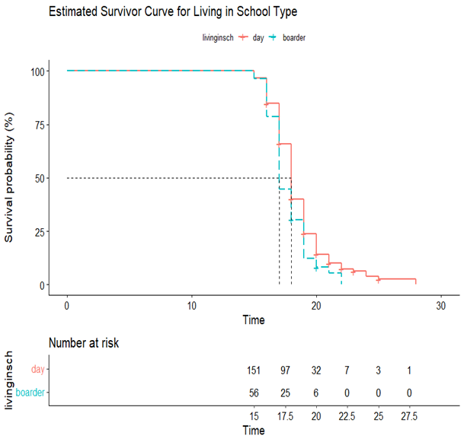
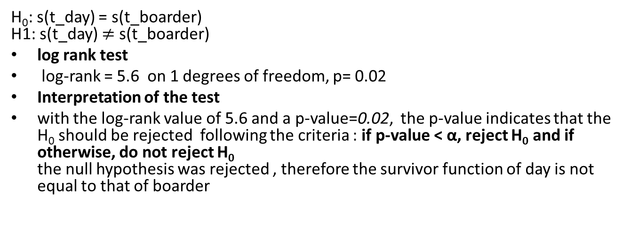
H₀: s(t_day) = s(t_boarder) H1: s(t_day) $≠$ s(t_boarder)
log rank test
log-rank = 5.6 on 1 degrees of freedom, p= 0.02
Interpretation of the test
with the log-rank value of 5.6 and a p-value=0.02, the p-value indicates that the H₀ should be rejected following the criteria : if p-value < α, reject H₀ and if otherwise, do not reject H₀ the null hypothesis was rejected , therefore the survivor function of day is not equal to that of boarder

Slide 18
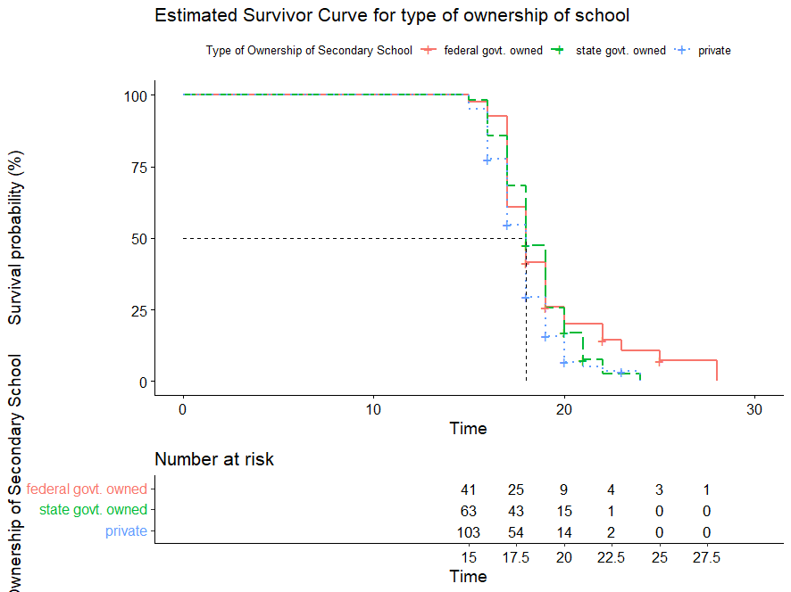
H₀ : there is no statistical difference amongst the survival curves of federal, state, and private owned schools H1: there is difference in at least one pair of the survival curves of federal, state, and privately owned schools
log rank test
log-rank = 7.6 , p= 0.02
Interpretation of the test
with the log-rank value of 7.6 and a p-value=0.02, the p-value indicates that the H₀ should be rejected following the criteria : if p-value < α, reject H₀ and if otherwise, do not reject H₀ the null hypothesis was rejected , therefore there’s at least one Kaplan-Meier curve that is not equal to the rest.

Slide 19
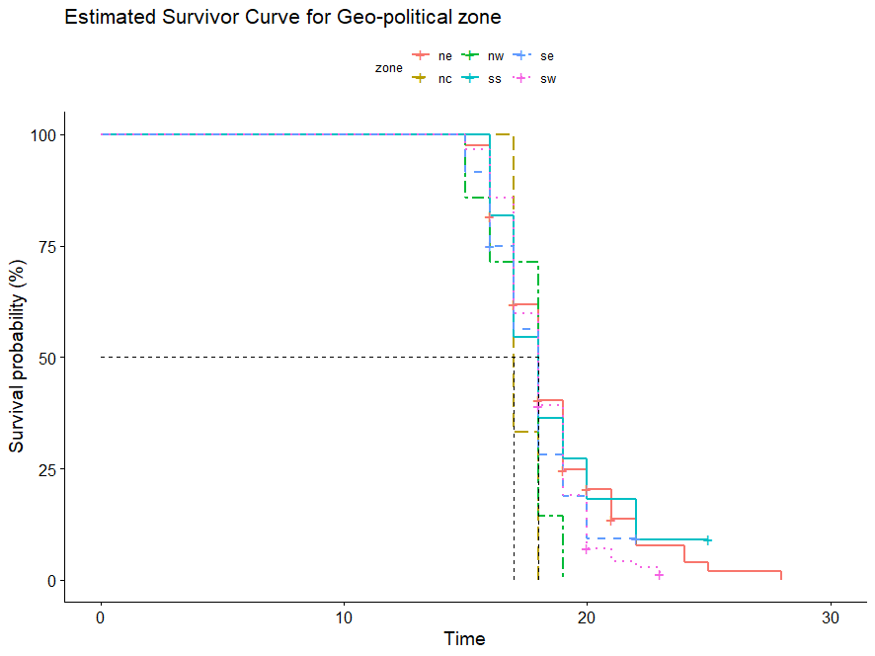
Zone | NC | NE | NW | SE | SS | SW
median | 18 | 17 | 18 | 18 | 18 | 18
H₀: : there is no statistical difference amongst the survival curves of zones
H₁: there is difference in at least one pair of survival curves of zones
log rank test
log-rank = 4.7 , p-value= 0.4
Interpretation of the test
with the log-rank value of 4.7 and a p-value=0.4, the p-value indicates that the H₀ should not be rejected. This means there’s difference in at least one pair of survivor curves.

Slide 20
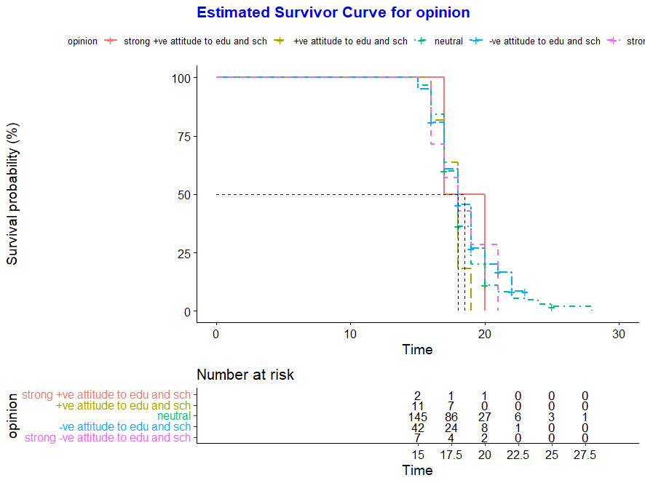
H₀ : there is no statistical difference amongst the survival curves of different groups of opinion H₁: there is difference in at least one pair of the survival curves of opinion
log rank test
log-rank= 2.7 , p= 0.6
Interpretation of the test
with the log-rank value of 2.7 and a p-value=0.6, the p-value indicates that the H₀ should not be rejected following the criteria : if p-value < α, reject H₀ and if otherwise, do not reject H_{0.} Since the null hypothesis was not rejected , there’s no significant difference between the survival curves.

Slide 21
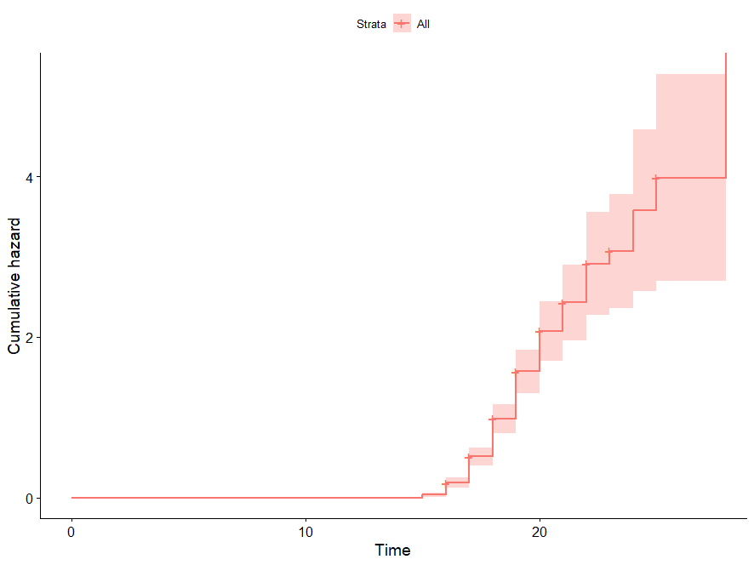
Nelson-Aalen Cummulative Hazard Rate

Slide 22
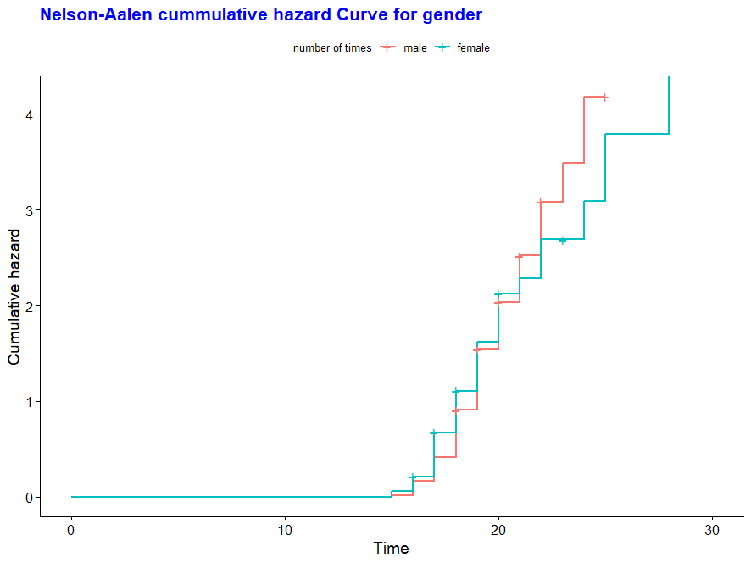
Cummulative Hazard for Gender

Slide 23
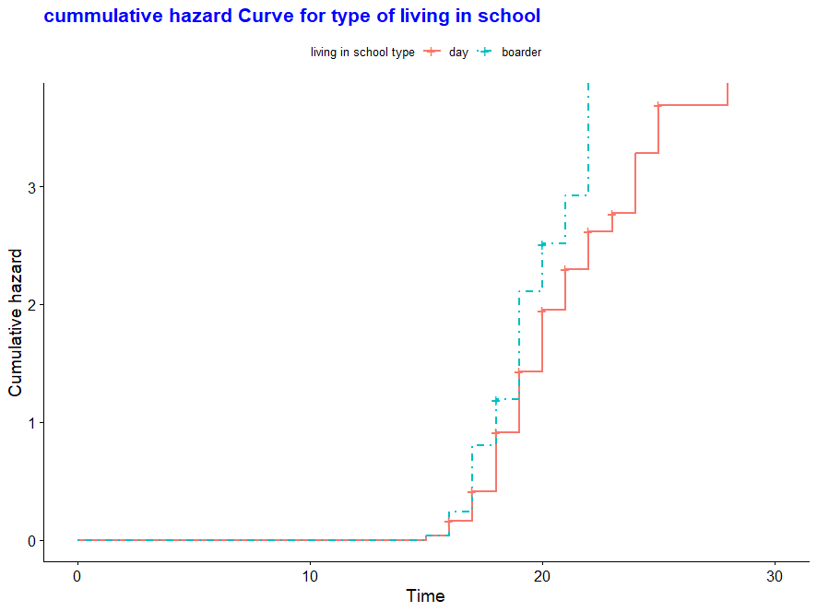
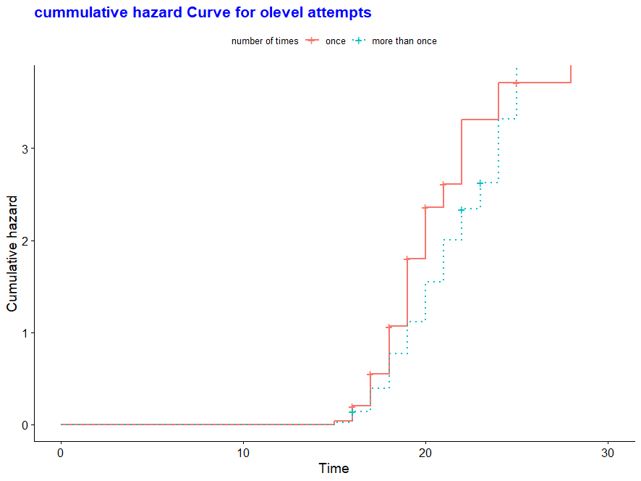

Slide 24
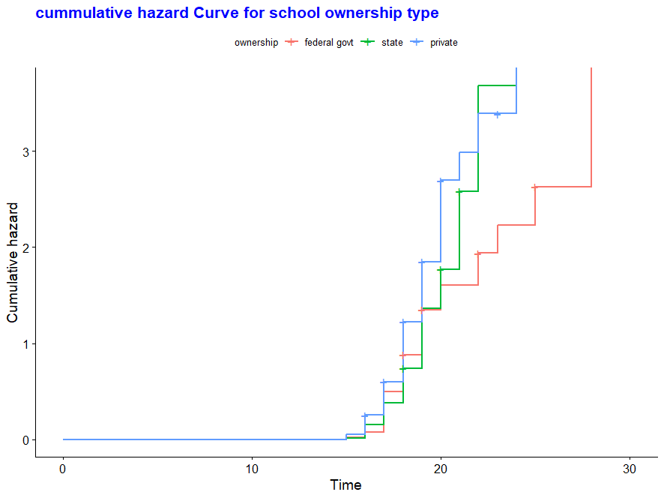
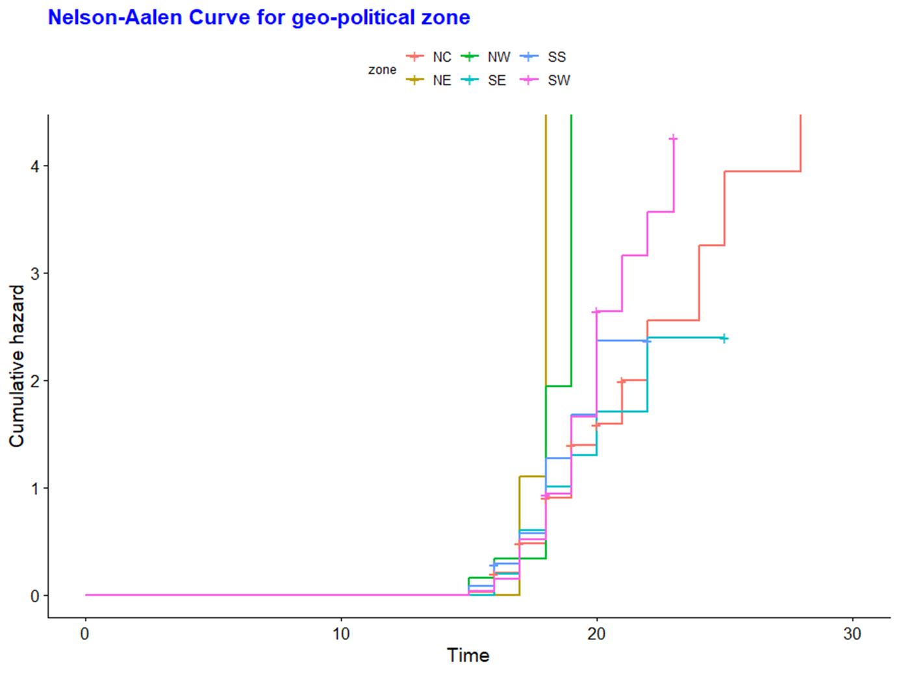

Slide 25
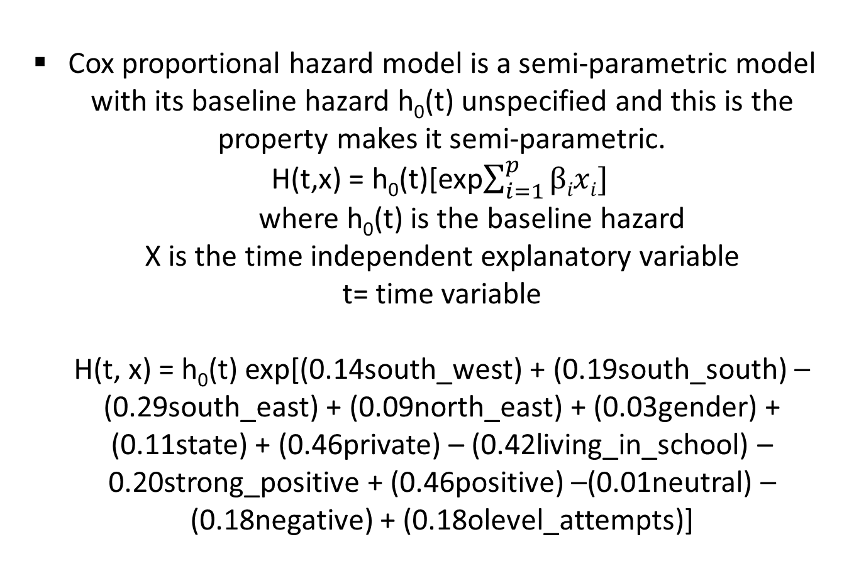
Cox proportional hazard model is a semi-parametric model with its baseline hazard h₀(t) unspecified and this is the property makes it semi-parametric. H(t,x) = h₀(t)[exp$\sum_{i=1}^{p}{βixi}]$ where h₀(t) is the baseline hazard X is the time independent explanatory variable t= time variable H(t, x) = h₀(t) exp[(0.14south_west) + (0.19south_south) – (0.29south_east) + (0.09north_east) + (0.03gender) + (0.11state) + (0.46private) – (0.42living_in_school) – 0.20strong_positive + (0.46positive) –(0.01neutral) – (0.18negative) + (0.18olevel_attempts)]
Cox Proportional Hazard Model

Slide 26
Summary
The Kaplan-Meier survival function was conducted.
The log-rank test statistic was carried out to compare the survival curves.
The Nelson-Aalen hazard curve was conducted
Based on the analysis carried out, it was deduced that majority of the survival curves have their mean age at admission to be 18
The survival curves are statistically different for:
Living in school type
Ownership of secondary school
Zone
…but the other covariates.
We modelled the data using the cox semi-parametric .

Slide 27
Reference
Ani Katchova. Survival analysis,2013
David G. Kleinbaum, & Mitchel Klein. Survival analysis- A self learning text (statistics for biology and health sciences)
Prof. Mike Marin. Lectures in statistics.
Zedstatistics.com
Terry Therneau. A package for survival analysis in R, 2021
Statisticsmentor.com

Slide 28
THANK YOU

